Slide 1
Can AI Solve Mysteries?
Using Graph Neural Networks For Root Cause Inference
By: Arun Ghosh

Slide 2
Contents
Motivation
01
Procedure
02
Results
03
Conclusions
04

Slide 3
Why Mysteries?
A mystery is essentially a root-cause inference problem, which is well suited for graph representation and highly applicable to operations research. The goal is not just to get the correct answer but to find evidence that AI can logically analyze graphs of “clues”.

Slide 4
What Do I Hope To Accomplish?
01
03
Analyze a graph of actors, events (with outcomes), and participation (gives clues) to generate a probability distribution of causes.
Parse a full textual input (a “story”) into the basic textual input, to show that AI can extract information and gauge its relevance.
02
Parse a basic textual input (a basic summary of actors and events) into a graph structure.

Slide 5
Project roadmap
Phase I
Phase 2
Phase 3
Bipartite GNN performs root cause inference on graph problem
NLP model extracts a dictionary of info to feed GNN from natural language problem description
LLM extracts a simple problem description from a narrative

Slide 6
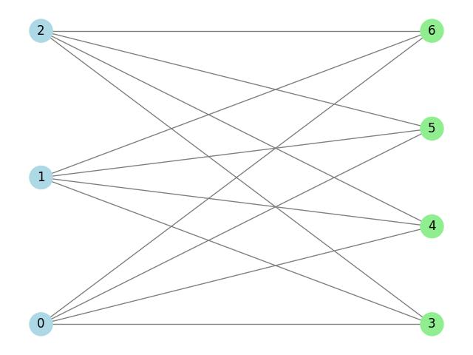
01
Bipartite GNN
Input: bipartite graph of factories and stores they supply
Store nodes contain product inspection results
Output: estimated passing rate of products for each factory

Slide 7
Training Process
01
Randomly generate test scenario parameters, split into train, test, and validation sets
02
Evaluate against bot baselines, including Gauss-Markov approximation of Bayesian model
03
Validate that a graph structure is actually needed, or if a simpler MLP can be used instead

Slide 8
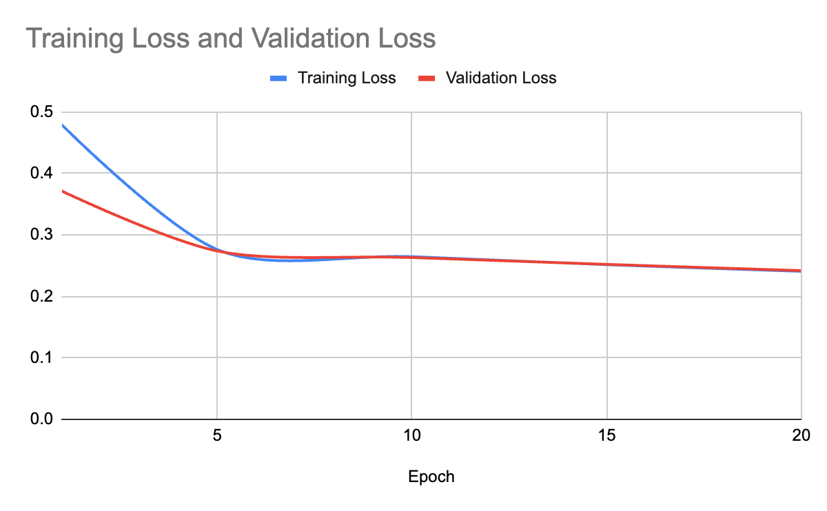

Slide 9
Model | Quality MAE ↓ | Quality MSE ↓ | F1-Score ↑ | Precision ↑ | Recall ↑ | Accuracy ↑ | ROC-AUC ↑ | PR-AUC ↑ | Optimal Threshold
Baseline A — Naive | 0.054 | 0.005461 | 0.4598 | 0.3611 | 0.6329 | 0.8169 | 0.7913 | 0.4531 | 0.57
Baseline B — Fail-Only | 0.0328 | 0.003918 | 0.2955 | 0.1808 | 0.8075 | 0.526 | 0.6663 | 0.1884 | 0.01
Baseline C — Constraint | 0.0337 | 0.003651 | 0.3892 | 0.3984 | 0.3805 | 0.853 | 0.6499 | 0.4276 | 0.5
Baseline D — Bayesian | 0.0291 | 0.002528 | 0.4985 | 0.461 | 0.5426 | 0.8656 | 0.8335 | 0.5095 | 0.3
GNN — Proposed | 0.0298 | 0.002124 | 0.5552 | 0.5613 | 0.5492 | 0.8917 | 0.87 | 0.6151 | 0.26

Slide 10
Model | Quality MAE ↓ | Quality MSE ↓ | F1 ↑ | Precision ↑ | Recall ↑ | Accuracy ↑ | ROC-AUC ↑ | PR-AUC ↑ | Threshold
Baseline A — Naive | 0.054 | 0.005461 | 0.4589 | 0.36 | 0.6329 | 0.8163 | 0.7913 | 0.4531 | 0.56
Baseline B — Fail-Only | 0.0328 | 0.003918 | 0.2849 | 0.1833 | 0.6388 | 0.6052 | 0.6663 | 0.1884 | 0.02
Baseline C — Constraint | 0.0337 | 0.003651 | 0.3892 | 0.3984 | 0.3805 | 0.853 | 0.6499 | 0.4276 | 0.5
Baseline D — Bayesian | 0.029 | 0.002519 | 0.4828 | 0.5553 | 0.4271 | 0.8874 | 0.836 | 0.5161 | 0.41
MLP Baseline | 0.0183 | 0.000852 | 0.841 | 0.8783 | 0.8068 | 0.9625 | 0.9666 | 0.905 | 0.24
GNN — Proposed | 0.0323 | 0.00228 | 0.5408 | 0.6035 | 0.49 | 0.8976 | 0.8713 | 0.6086 | 0.38
GNN Ablation A — No Edges | 0.0306 | 0.002485 | 0.5003 | 0.4406 | 0.5788 | 0.8577 | 0.8391 | 0.5445 | 0.2
GNN Ablation B — No Stores | 0.0325 | 0.002593 | 0.4691 | 0.3719 | 0.6351 | 0.8231 | 0.8322 | 0.4955 | 0.17
GNN Ablation C — No Conn | 0.0329 | 0.00283 | 0.4583 | 0.3573 | 0.6388 | 0.8141 | 0.7911 | 0.3322 | 0.17

Slide 11
Model | Quality MAE ↓ | Quality MSE ↓ | F1 ↑ | Precision ↑ | Recall ↑ | Accuracy ↑ | ROC-AUC ↑ | PR-AUC ↑ | Threshold
GNN (Proposed) | 0.0285 | 0.002129 | 0.546 | 0.6692 | 0.4611 | 0.9056 | 0.8777 | 0.6278 | 0.31
MLP Baseline — No Success Rate | 0.0325 | 0.00266 | 0.4573 | 0.3568 | 0.6366 | 0.814 | 0.8174 | 0.4593 | 0.19
Model | Quality MAE | Quality MSE | F1-Score | Precision | Recall | Accuracy | ROC-AUC | PR-AUC | Threshold
GNN (Proposed) | 0.0305 | 0.00216 | 0.56 | 0.6003 | 0.5248 | 0.8985 | 0.875 | 0.6227 | 0.26
MLP Baseline (Advanced) | 0.0366 | 0.00335 | 0.4546 | 0.3538 | 0.6358 | 0.8122 | 0.8135 | 0.4427 | 0.19

Slide 12
02
NLP Spec Extraction
Input: A report with various levels of noise and verbosity
Identify and extract relevant information
Output: A dictionary that is easily converted into a graph for the GNN

Slide 13
NLP Setup
01
Test against deterministic rule-based extractors to justify the use of AI for graph extraction
02
Determine the level of NLP necessary for a passing level of accuracy (LLMs and SLMs deemed unnecessary)
03
Improve downstream robustness of the GNN, and implement Cross-Encoder Relation Classifier

Slide 14
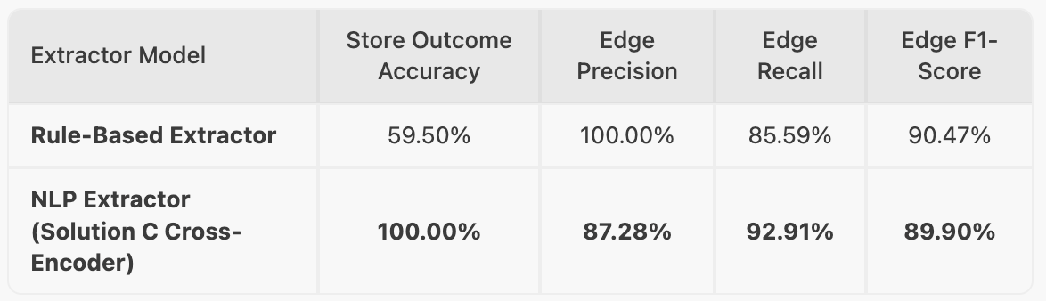

Slide 15
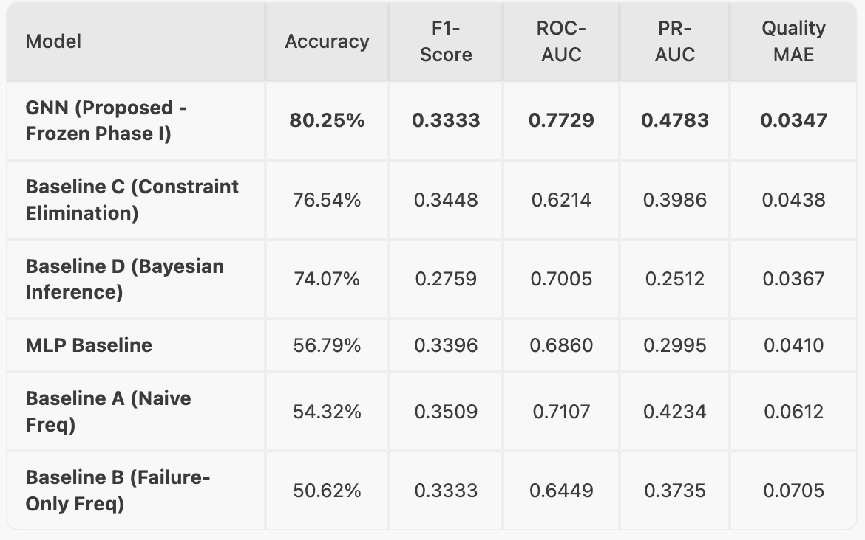

Slide 16
03
LLM Problem Extraction
Input: A full-length “mystery” with the structure of a root-cause inference problem
Oral transcript of a social deduction game, for instance
Output: A translation of the mystery into a simple report to feed the NLP

Slide 17
Phase III Setup
01
Develop a social deduction game tailored to mirror the Phase II scenarios
02
Generate solutions and oral transcripts of those games for LLMs to summarize and feed into the NLP-GNN pipeline
03
Compare the downstream performance of ChatGPT, Claude, and Gemini summaries

Slide 18
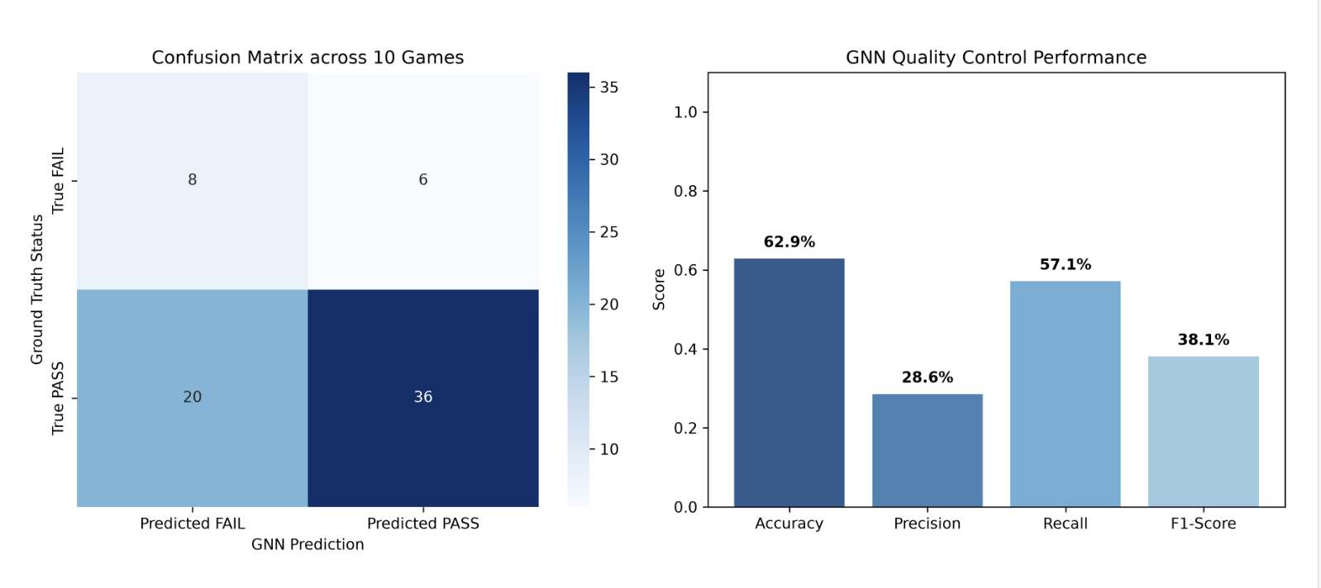
ChatGPT 5.5 (Instant)

Slide 19
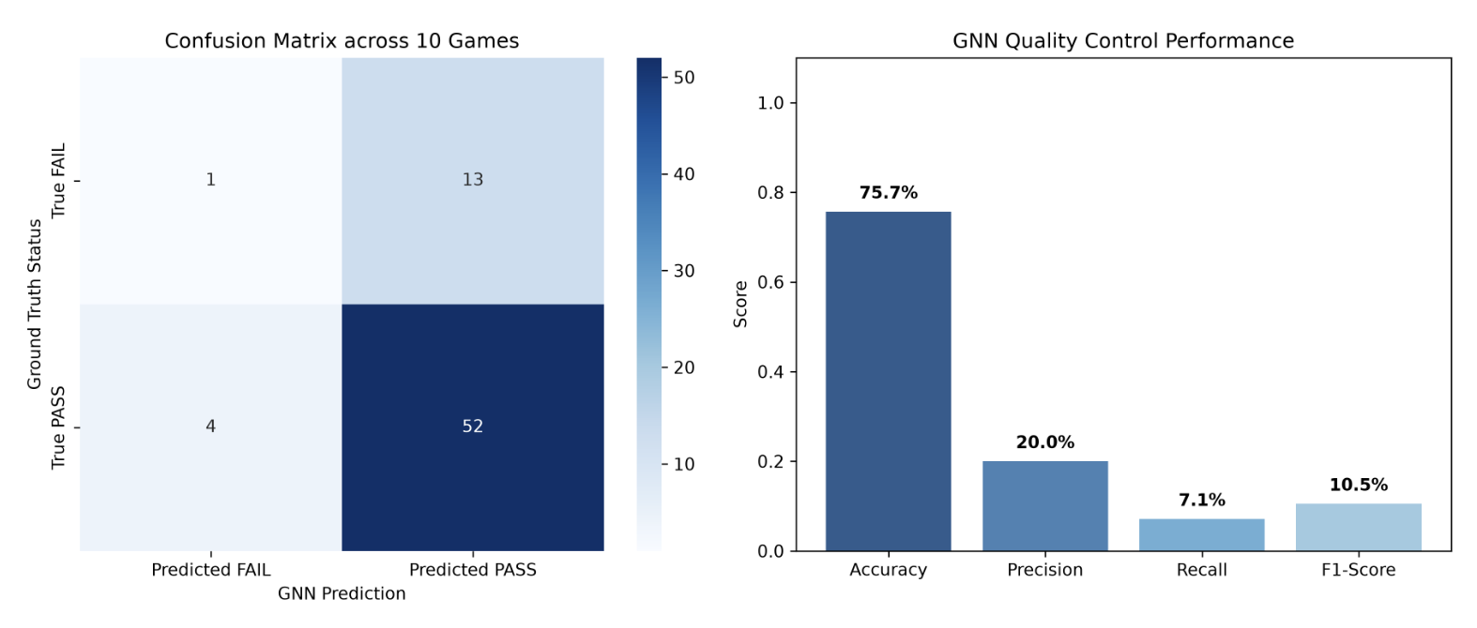
Claude Sonnet 5 (Medium)

Slide 20
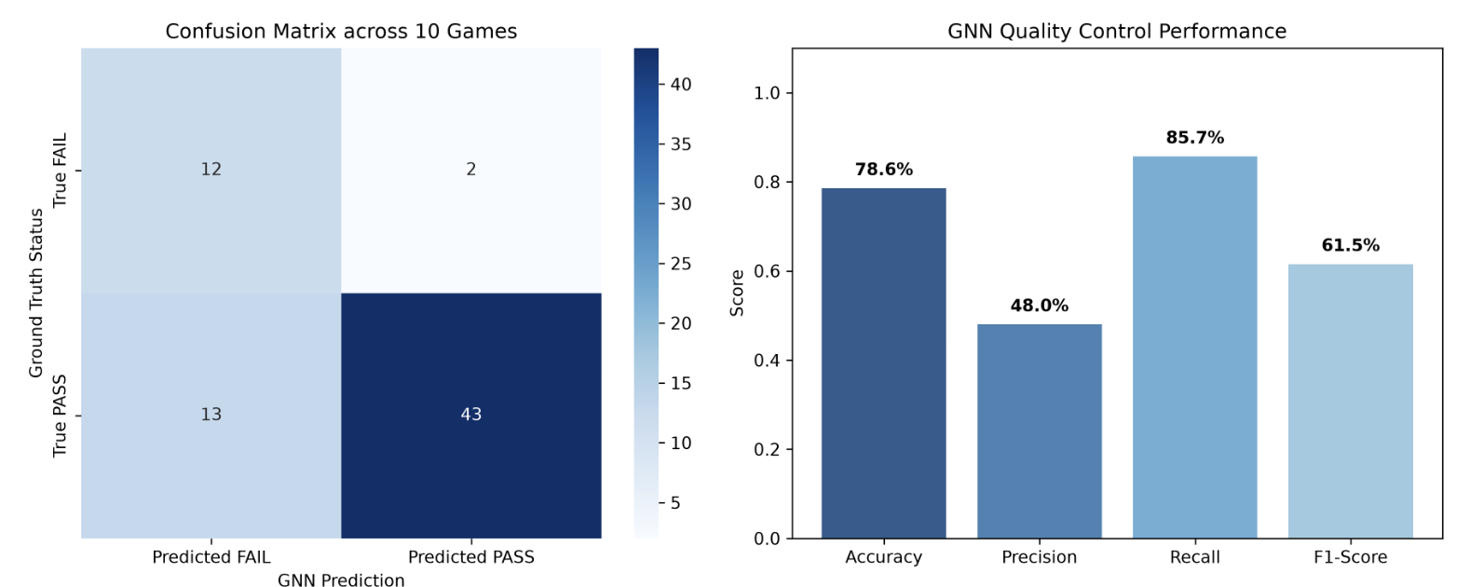
Gemini 3.6 Flash (Medium)

Slide 21
Conclusions
GNN Dominance
The GNN model consistently outperformed the baselines in all metrics
GNN Robustness
Performance did not deteriorate when NLP gave it partially accurate graphs
Mystery Solving Capability
Gemini’s summaries has the highest downstream metrics

Slide 22
Next steps
Step 1
Step 2
Step 3
Step 4
Develop bipartite GNN for root cause inference
Develop NLP for graph extraction from text prompts
LLM extracts text prompt from transcript of social deduction game (a “mystery”)
Implement pipeline in a full supply chain problem

Slide 23
Q&A
Any questions?
Ask away!

Slide 24

Thank you!
Company Name
Date
Questions?
Please reach out to
name@example.com

